Slide 1
CSP 586
Environment
Dashboard
Team 22
Elliot Chibe
Vinay Jagannath
Sashank Vanajakshi

Slide 2
Overview
Using an online dashboard to provide users the access to explore and analyze the Environmental Complaints data kept by the City of Chicago
Why is this important?
Keeps politicians honest
Transparency in government
Applications
Check your neighborhood
See what’s getting done

Slide 3
Functionality
Select a dataset
Sort on column
Select within column
Select column by name
Export data
Clear data
Show Statistics
Create charts

Slide 4
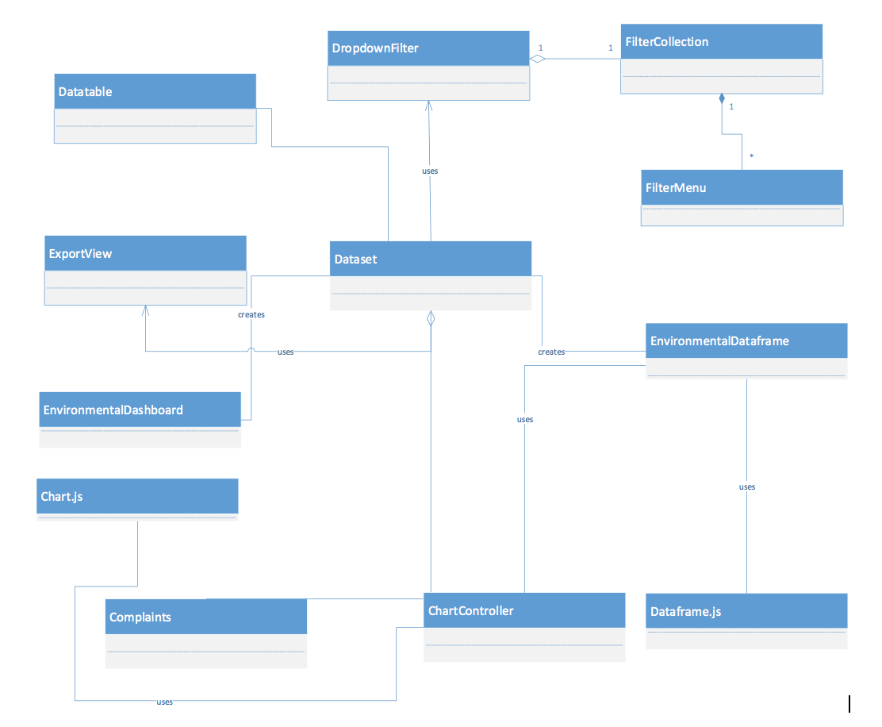
Analysis Model Class Diagram

Slide 5
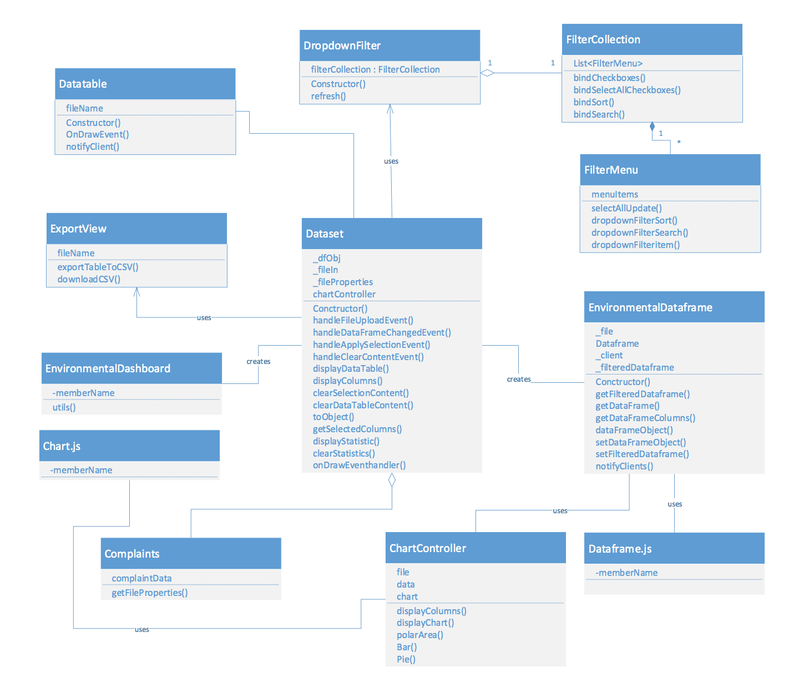
Design Model Class Diagram

Slide 6
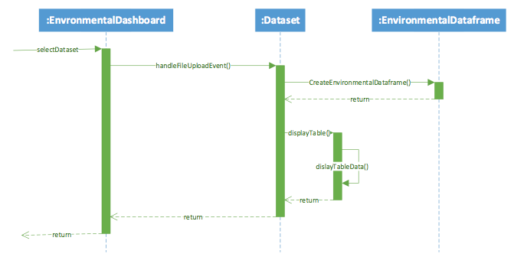
Sequence Diagram

Slide 7
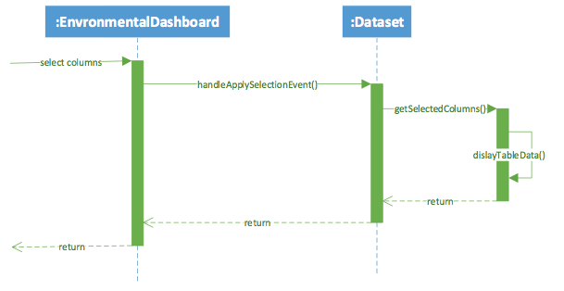
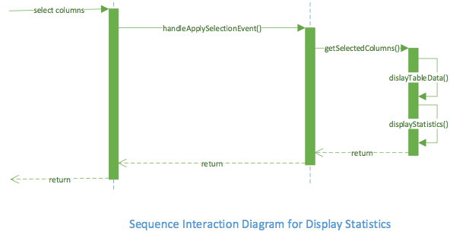
Sequence Diagram Continued

Slide 8
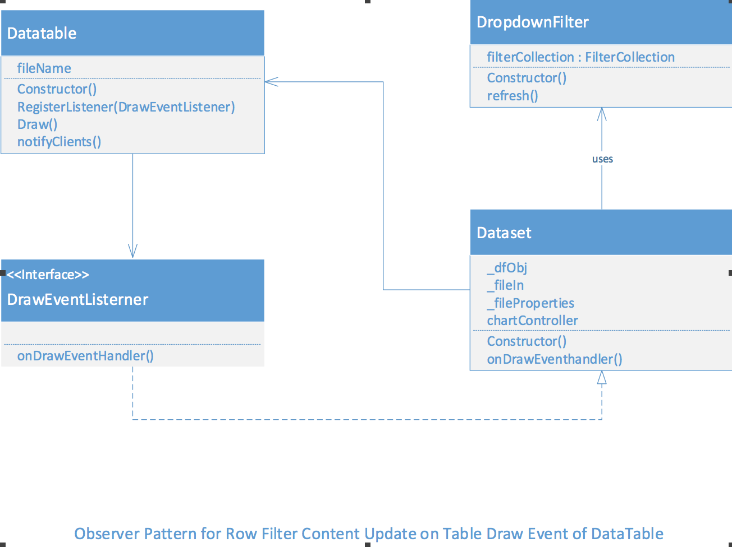
Observer Design Pattern

Slide 9
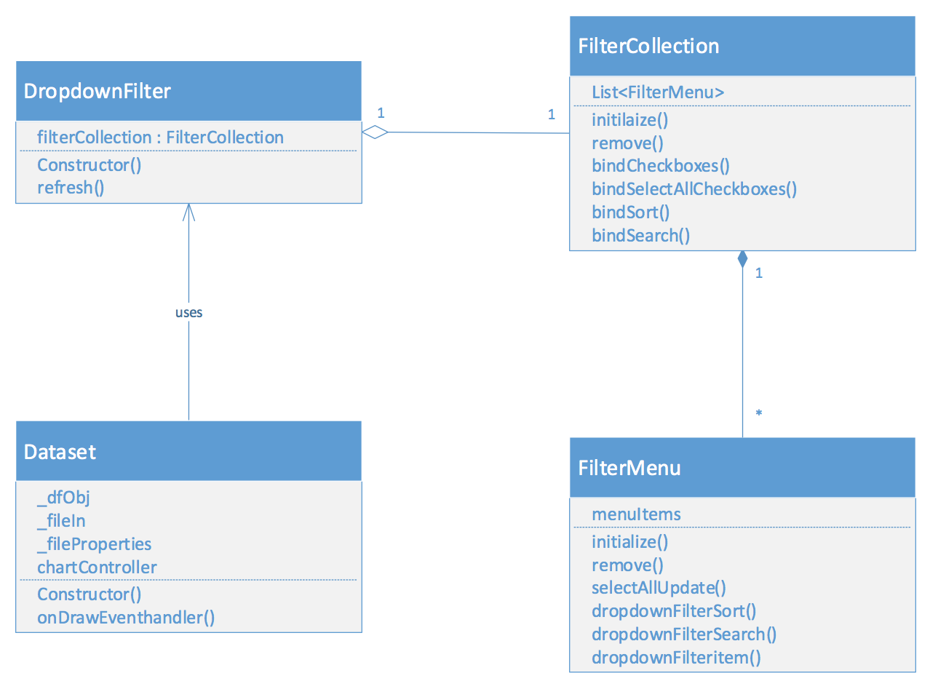
Facade Design Pattern

Slide 10
References
Datasets:
City of Chicago Database
https://data.cityofchicago.org/Environment-Sustainable-Development/CDPH-Environmental-Complaints/fypr-ksnz

